Slide 1


School Staff
Training Presentation
2021

Slide 2
Who is this presentation for?
The following school staff will find this presentation helpful:
Classroom teachers who will be supervising the assessments on test day
IT support staff who will assist with device preparation and technical readiness.

Slide 3
Topics
1. What are ICAS Assessments?
2. Overview of the Assessments Portal
3. Administration tips
  3.1 Supervising teacher on test day
  3.2 IT support staff
4. Support resources

Slide 4
1. What are ICAS Assessments?

Slide 5
ICAS Assessments have been unrivalled for 40 years and continue to lead the way.
Elite annual competition to recognise academic excellence
Requires students to think beyond the classroom
Encourages students to attain greater academic success
Recognises and rewards student success through medals and certificates
Provides annual and objective ranking of performance.

Slide 6
Subjects for 2021:
    English
    Mathematics
    Science
    Digital Technologies
    Writing
    Spelling Bee
5-day sitting period per subject

Slide 7
2. Overview of the
Assessments Portal

Slide 8
Key roles in the platform
School staff member | Suggested role in the platform | Role tasks
Head of Curriculum/Head of Subject/Deputy Principal | School Coordinator (recommended to have more than 1) | Imports and manages student data, invites staff and assigns roles, allocates test licences to students, assigns classes to teachers (if needed), completes all Unrestricted Teacher/Teacher tasks
Classroom teacher, Grade Coordinator or teacher across classes within a year level, teacher of multiple classes across multiple year levels | Unrestricted Teacher | Prints student logins, supervises tests on the test day, views results. Assigned to classes automatically if the class field is being used. This is the recommended role for teachers who will be supervising the ICAS tests on test day
As above | Teacher | As above, but can only do the tasks for the classes they have been assigned.
Principal | School Leader | Can view results
Student | Student | Complete tests

Slide 9
Accessing the tests
 | Tests with no locked-down browser | Tests with locked-down browser (LDB)
Subjects | Digital Technologies, Science, Mathematics & English | Spelling Bee, Writing
Student login | Student navigates to: icas.site/start Logs in with: Test session code & One-time student code | Student clicks on the LDB icon on their desktop (LDB should be installed before test day). Logs in with: Test session code & One-time student code
Teacher login | Navigates to: icas.site/start Logs in with username and password
Teacher controls test start | Students can only start the test once the teacher clicks “start session” in the Assessments Portal
Notes:
Punctuation error highlighted.

Slide 10
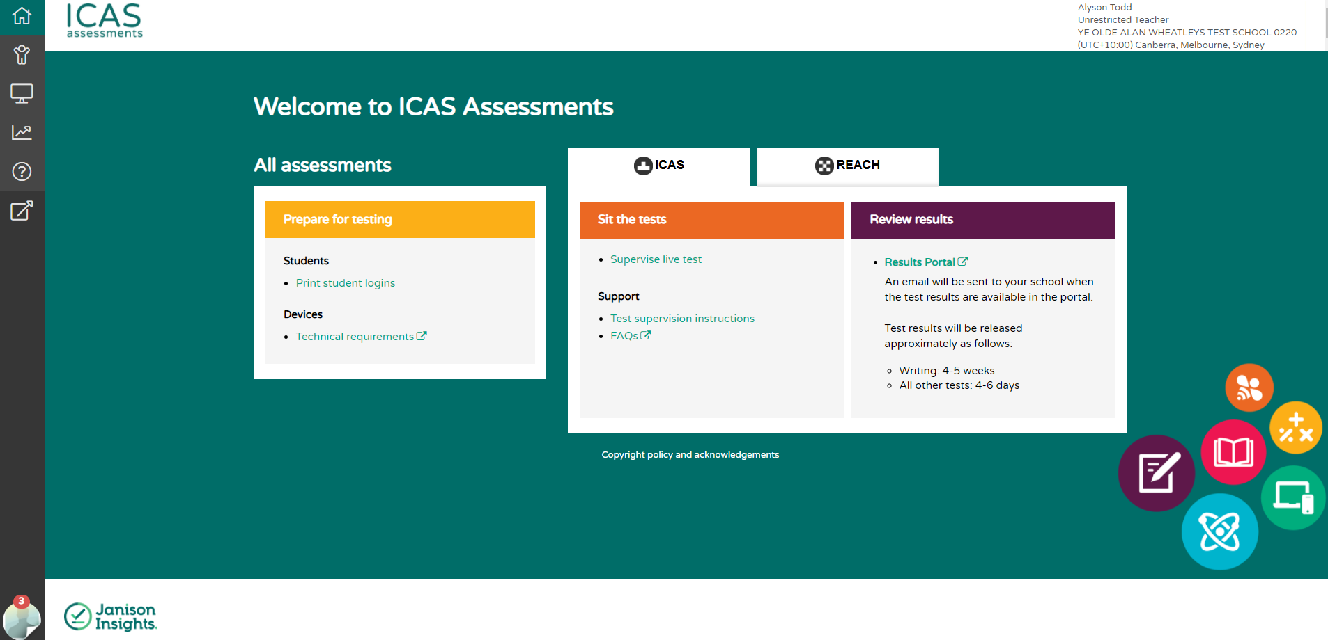
Teacher dashboard
Navigation
toolbar
Home
Students
Tests
Results
Support
Go to page
Teacher account details
Notifications
Quick links on the dashboard

Slide 11
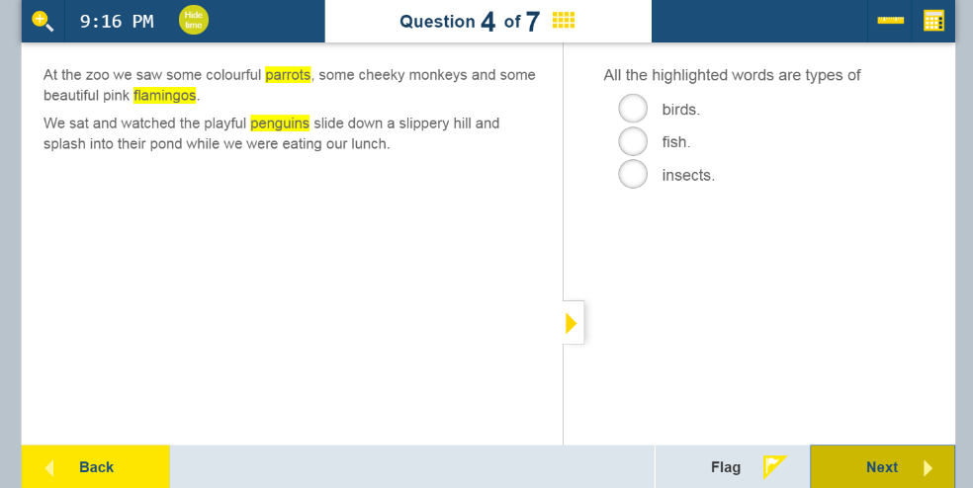
Student test player
Zoom
Clock
Calculator
Grid to track progress and review
Flag question to review later

Slide 12
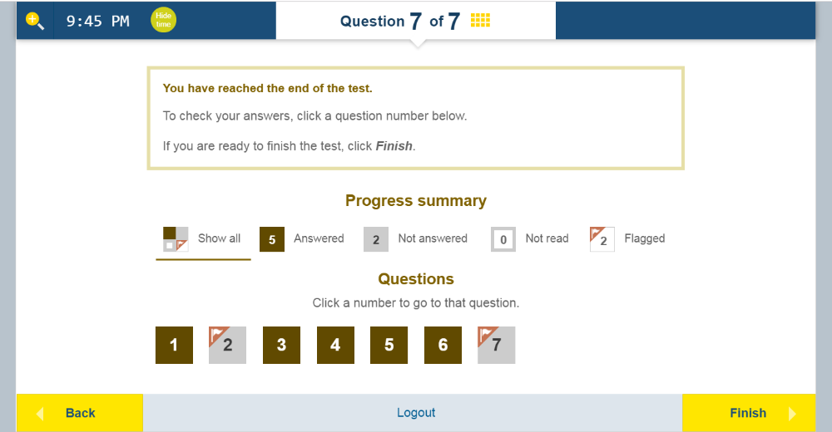
Student test player
Progress summary
Click to view flagged question

Slide 13
3. Administration tips
3.1 Teachers supervising on test day

Slide 14
Access the Assessments Portal before test day
New to the Assessments Portal?
    You should have received an activation email to register for the Portal. Your school coordinator or ICAS Assessments customer support can resend the email to you.
Previous user?
      You can use the forgot password on the login page or contact your School Coordinator who can look up your username and reset your password.

Slide 15
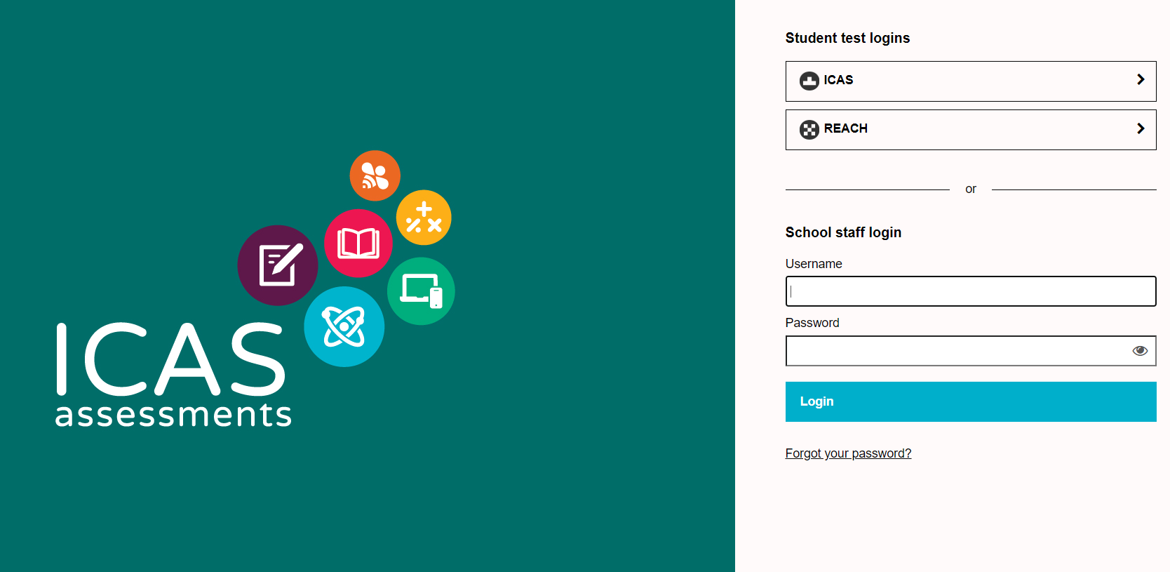
Finding the Assessments Portal
Short cut - icas.site/start
Log in here

Slide 16
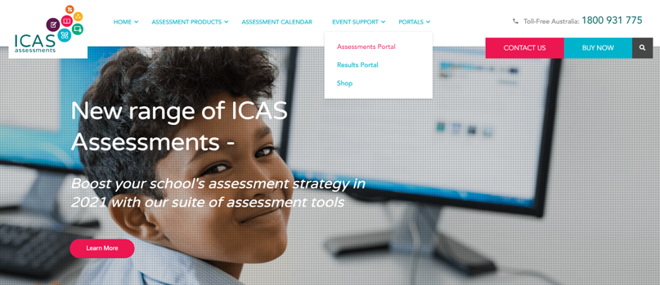
Finding the Assessments Portal
From website home page – icasassessments.com
Select Portals,
Click Assessments Portal, Click login
Log in here

Slide 17
Test supervision instructions
Make sure you have read the Test Supervision Instructions for the relevant subject.
    Includes step-by-step instructions, a script to read out to students and troubleshooting tips.
    Accessible from your dashboard in the Assessments Portal and on the ICAS Product support page on the ICAS Assessments website.

Slide 18
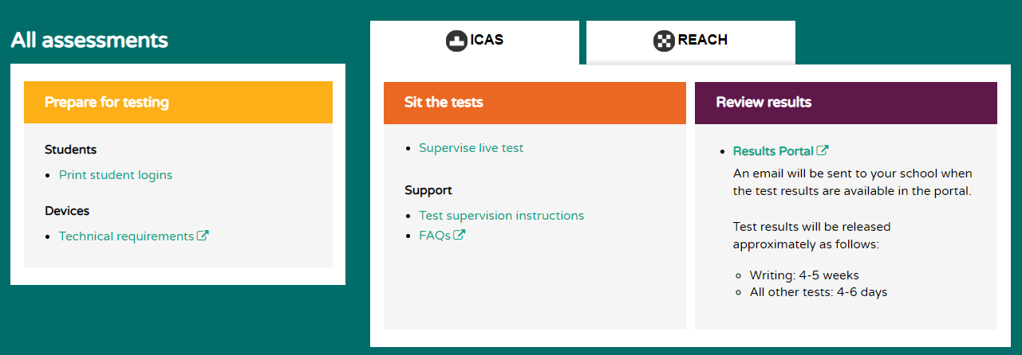
Test supervision instructions
Assessments Portal Teacher Dashboard
Quick link to test supervision instructions

Slide 19
Print student logins (one-time codes)
Your school coordinator will either provide the student one-time codes, or ask you to print them yourself.
Make sure you have these handy on test day to distribute to the students.

Slide 20
The next 4 slides show how to print student logins. You can ignore these if your school coordinator is providing them to you.

Slide 21
Print student logins
The school coordinator or the unrestricted teacher/teacher user roles can print student logins.
If a student is sitting more than 1 subject they will need a unique one-time code printed for each subject they are sitting.
Student data must be imported and test licences must be allocated to students before the one-time codes can be printed (School Coordinator role does these 2 tasks).
Australian & New Zealand schools note: if your school is using the Parent Payment System the student import and test licence allocation is done automatically for you.

Slide 22
Print student logins
1. Select print student logins on the dashboard

Slide 23
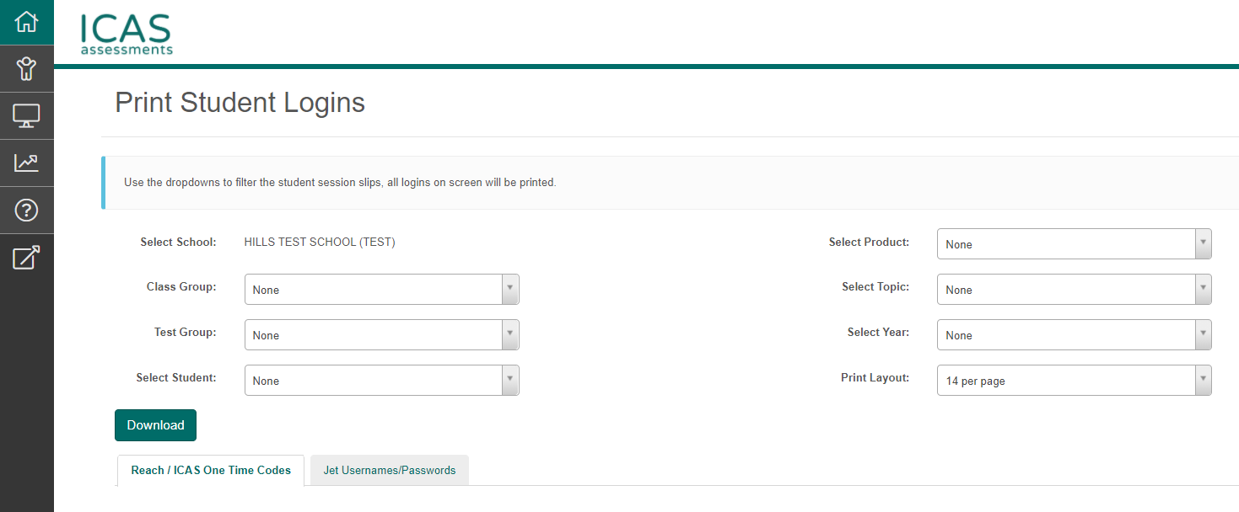
Print student logins
2. Use the drop downs to filter to the required test
5. Click download to generate a PDF which can be printed
3. Choose print layout
4. List of students will appear under this tab based on filters selected

Slide 24
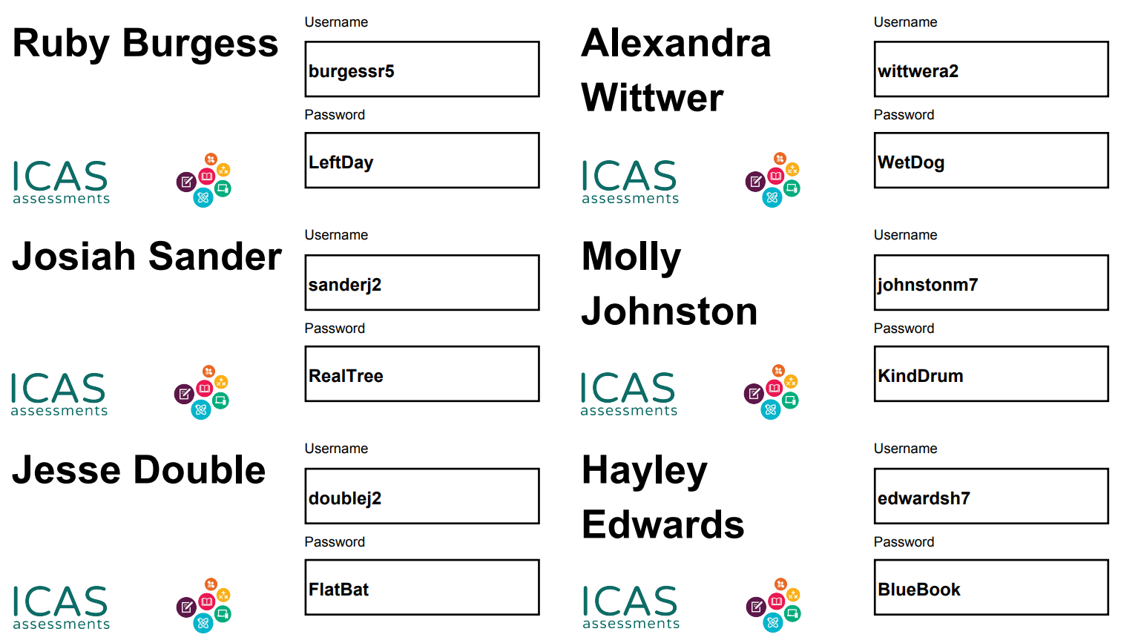
Print student logins
Choice of format for printing logins: 14, 4, or 1 per A4 page

Slide 25
Supervise live test
The supervising teacher MUST be logged into the Assessments Portal and access the Supervise live Test screen to do the following:
      Create and start the test session
      Troubleshoot connectivity issues, e.g. student’s laptop battery fails
      Track student progress through the test
      Check students have submitted their tests.

Slide 26
Supervising live test
Assessments Portal Teacher Dashboard
Quick link to Supervise live test screen

Slide 27
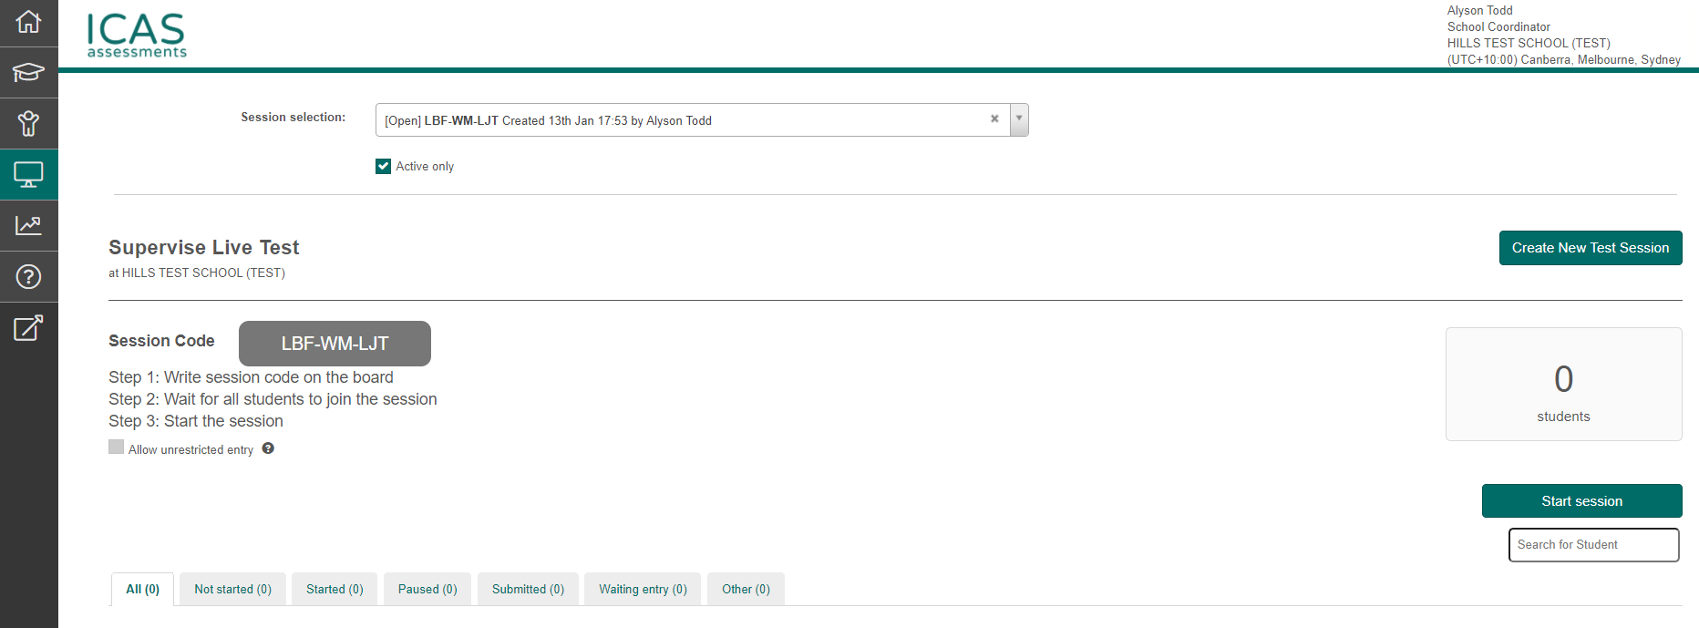
Supervising live test
1. Create new test session will automatically generate the test session code
2. Session code will appear in a grey rectangle
3. Once all the students have logged in with the session code and their one-time code you can click Start session to begin the test

Slide 28
Timing the test
The supervising teacher must manually time the test. There is a normal clock in the student test player. It is not a count down clock.
Notes:
Double spacing between “a and count”

Slide 29
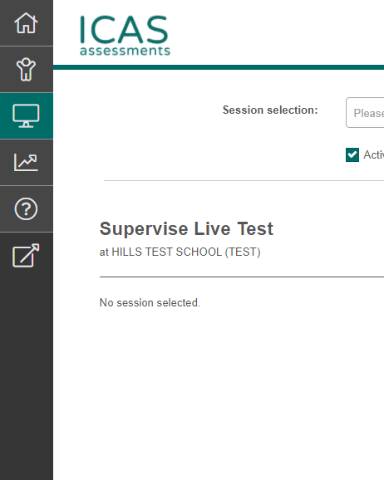
Resolving issues
Consult the troubleshooting tips in your test supervision instructions
Contact your School Coordinator/IT support
Access support resources in navigation toolbar in the Assessments Portal

Slide 30
3. Administration tips
3.2 IT staff preparing devices/technical readiness

Slide 31
Technical requirements
All ICAS Assessments:
  Read the technical requirements- icasassessments.com/support-technical-requirements
  Conduct the technical readiness test (TRT) on all student devices (link is on the technical requirements page) well before test day.
  Undertake the technical readiness test (TRT) using the internet connection/network that will be used for the assessment.
    icasassessments.com/support-technical-readiness/
Notes:
Check text of bold url – no “ I “

Slide 32
Additional requirements
ICAS Spelling Bee & ICAS Writing ONLY
Install the LDB (called Janison Replay).
NOTE: there is a manual locked-down browser readiness test which is noted at the end of the TRT.
A device passes the test if BOTH of these screens can be viewed (see 2 next slides).
ICAS Spelling Bee requires headsets.

Slide 33
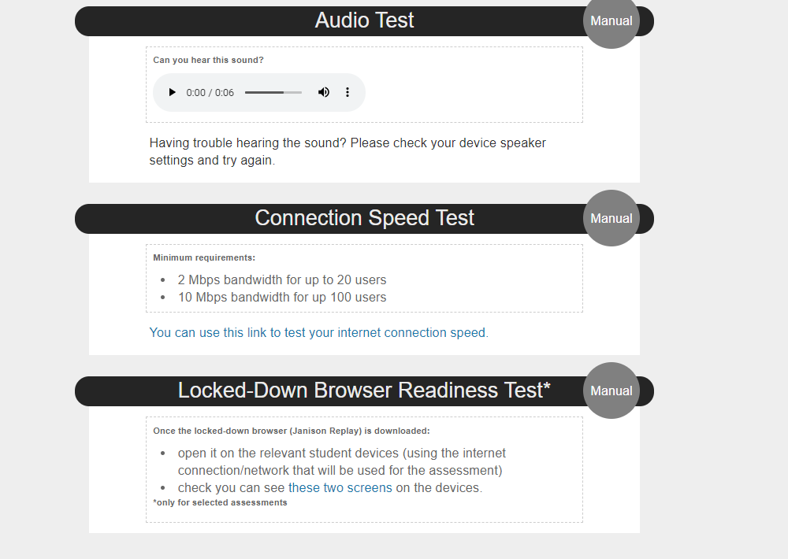
LDB readiness test
Extract from the technical readiness test
Go to the next slide to see the two screens

Slide 34
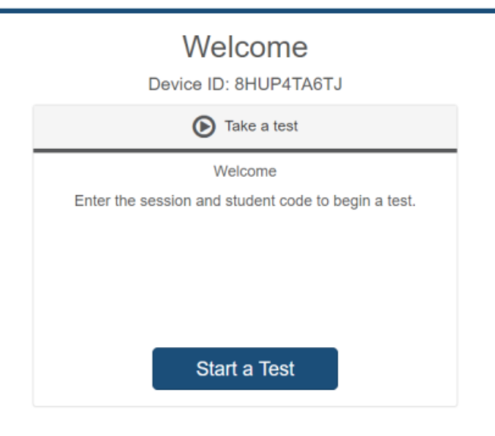
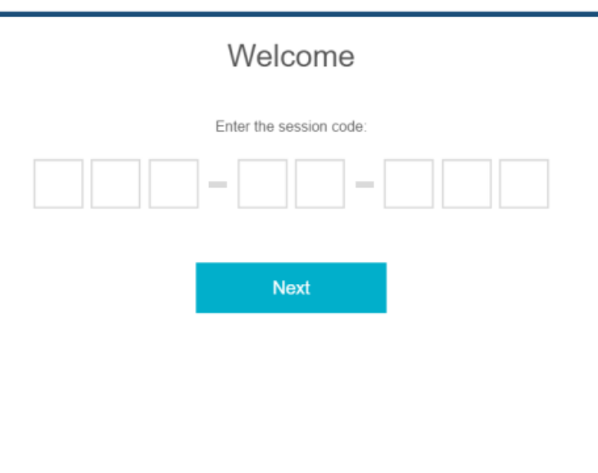
LDB readiness test
Screen 1 should be visible
Screen 2 should be visible
Click here to see screen 2

Slide 35
Troubleshooting
LDB readiness test. If you cannot see the two screens this means the device has not successfully connected to ICAS Assessments servers. Your network administrator may need to whitelist the servers based on the Client Network Firewall Configuration (details on technical requirements web page).
Use the Technical Readiness Test to help troubleshoot connectivity issues on test day.
Test supervision instructions have troubleshooting tips.

Slide 36
4. Support resources

Slide 37
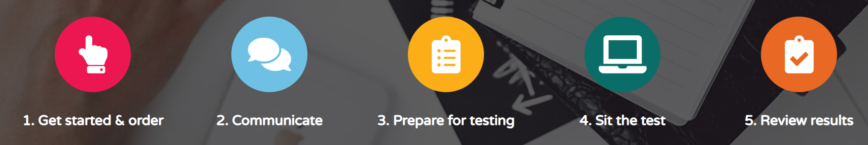
Support resources
Support resources have been divided into 5 sections so you can quickly access the relevant information icasassessments.com/support-icas/
Notes:
Check URL – old?

Slide 38
Support resources
Access support through the ICAS product support page on our website: icasassessments.com/support-icas.
Or
In the Assessments Portal go to support in the left hand navigation bar or access quick links on the dashboard.

Slide 39
Support resources
Contact us
icasassessments@janison.com.au
Australia toll-free: 1800 931 775
New Zealand toll-free: 0800 440 904
Pacific/International: +61 02 8267 8800

